Slide 20
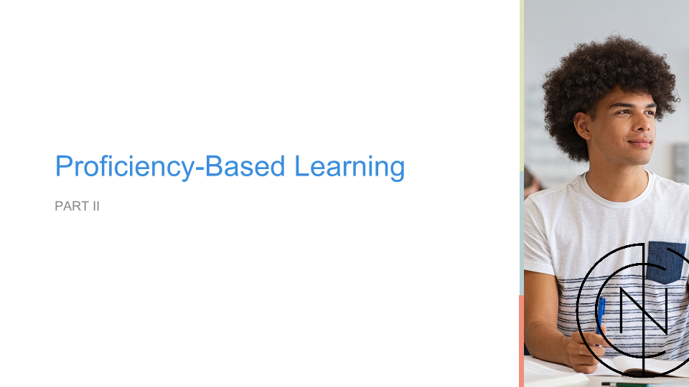

Slide 21
Characteristics of Proficiency/Competency-Based Systems
“Learning outcomes in which learning is constant and time is the variable.”
Students make decisions about learning experiences, how they create and apply knowledge and how they will demonstrate their learning. Student progress is based on evidence of proficiency rather than level of participation, effort or time spent in classroom.
Assessment is meaningful and empowering learning experience of students that yields timely, relevant and actional feedback.
Students receive relevant, varied instruction and timely, differentiated support based on their individual learning needs. Students learn actively using different pathways and varied pacing.
Strategies ensure equity for all students are embedded in culture, structure and pedagogy of schools and education systems. All students have access to personalized learning opportunities and high-quality instruction.
Learning targets are rigorous, common expectations for learning that clarify what to learn, how to deeply learn it and how to demonstrate evidence of new learning.
Notes:
Education Team
Michelle Exstrom, Director
Susan Love, Program Coordinator
Early Ed
Jorge Casares, Policy Associate
Patrick Lyons, Policy Specialist
K-12
Molly Gold, Senior Policy Specialist
Emily Ronco, Policy Analyst
Daniel Thatcher, Senior Fellow
Marilyn Villalobos, Policy Associate
Student Supports
Ashley Wallace, Associate Director
Autumn Rivera, Policy Associate
Post-Secondary Ed
Sunny Deye, Associate Director
Andrew Smalley, Policy Associate
Marilyn Villalobos, Policy Associate
Federal Affairs
Austin Reid, Senior Legislative Director for Federal Ed Policy
Patrick Lawler, Legislative Associate

Slide 22
Source: Aurora Institute CompetencyWorks

Slide 23
Field Updates Definition in 2019 Source: Aurora Institute https://aurora-institute.org/wp-content/uploads/what-is-competency-based-education-an-updated-definition-web.pdf
Students are empowered daily to make important decisions about their learning experiences, how they will create and apply knowledge, and how they will demonstrate their learning.
Assessment is a meaningful, positive, and empowering learning experience for students that yields timely, relevant, and actionable evidence.
Students receive timely, differentiated support based on their individual learning needs.
Students progress based on evidence of mastery, not seat time.
Students learn actively using different pathways and varied pacing.
Strategies to ensure equity for all students are embedded in the culture, structure, and pedagogy of schools and education systems.
Rigorous, common expectations for learning (knowledge, skills, and dispositions) are explicit, transparent, measurable, and transferable.

Slide 27
Proficiency/Competency-based Education in the States
Source: Aurora Institute at https://aurora-institute.org/cw_post/competency-based-education-across-america/

Slide 32
NCSL 50-State Searchable Tracking Databases
Education Program Tracking Database
https://www.ncsl.org/research/education/education-bill-tracking-database.aspx
At least 316 enactments in 2022 in every state
Notes:
Early Care and Education
The Early Care and Education database tracks and updates early care and education legislation from the 50 states and the territories. Issues include child care and child care financing, early childhood services, prekindergarten, professional development, home visiting, infants and toddlers, and financing early education. This database is made possible by the generous support of the Alliance for Early Success.
Education
The NCSL Education bill tracking database tracks state education legislation on more than 50 issues spanning grades P-12 and higher educaton. The database includes enacted legislation only (2008 to present).
Education Finance
This database provides a detailed look at state finance data, including expenditures and state and local revenue, in addition to a history of school finance litigation.
Postsecondary Education
This database contains legislation related to postsecondary education. Topics include admissions, enrollment, appropriations, athletics, campus safety, college preparation, corrections and prison education, credentials, credit for prior learning, dual enrollment, financial aid, affordability, free speech, rural education, student loans, student supports, tuition and fees, undocumented students, veterans, vocational education and workforce development (2019 to present).
Preschool-Third Grade Education
NCSL’s interactive preschool-3rd grade legislative tracker captures pending and enacted bills from a wide variety of early learning policy areas, including preschool, dual language learners, governance, literacy, STEM, family engagement and more.
School Safety
Tracks state legislation addressing issues of school safety, including, but not limited to, firearms at K12 schools, school resource officers, threat assessments, building infrastructure, and the coordination of mental health services (2017 - present).
Student Loan Bill Tracking Database
The NCSL Student Loan Bill Tracking Database is a comprehensive tool for following state action on student loan debt issues. It tracks enacting, pending, and failed legislation related to student loan topics such as forgiveness, oversight, licensure, and taxes. Using the interactive Power BI format, users can also find and sort legislation by state or year since 2015. This database is made possible through generous support from the Annie E. Casey Foundation (2015 to present).

Slide 33
NCSL Web Resource: https://www.ncsl.org/research/education/teacher-shortage-areas-by-state.aspx

Slide 34
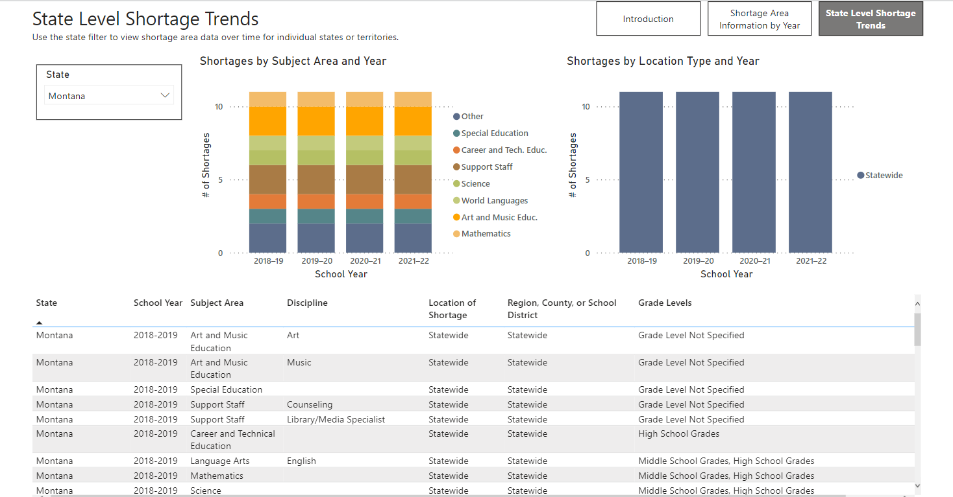

Slide 35
New Mexico Making Progress
Long-time Partnership with Teacher Preparation Programs
Tiered-licensure System with Performance Evals for nearly 20 years
Cultural Competency and Diverse Teachers – 2022 HB 60
Grow-Your-Own Scholarship - 2021 HB 22
Teacher Salaries - $10k raise – 2022 SB 1
Teacher Residencies - 2022 HB 13
Recruiting Retired Teachers – 2022 HB 73
Teacher Prep/PD on Science of Reading in 2023

Slide 42
NCSL Webinar: https://www.ncsl.org/research/education/careerwise-colorado-youth-apprenticeship-inspired-by-swiss-vet.aspx

Slide 43
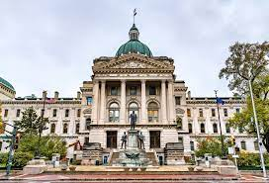
Indiana Making Progress
Coordinated Statewide Effort Led by Legislature, Gov, Dept of Education and Workforce Boards
Graduation Pathways to Ensure College and Career Readiness
Increased Allowed Assessments for Graduation
Partnership with Ivy Tech Community Colleges for HS Students
Partnership with Industry
Investment from Local Philanthropy
Studied Swiss Model (Basis for Apprenticeships)
Created Apprenticeships in Shortage Industries

Slide 51
NCSL 50-State Searchable Tracking Databases
Early Education Enactment Database
https://www.ncsl.org/research/human-services/early-care-and-education-bill-tracking.aspx
At least 134 enactments in 37 states in 2022
Overview of Early Education and Care Policy
https://www.ncsl.org/research/human-services/early-childhood-101.aspx
Notes:
Early Care and Education
The Early Care and Education database tracks and updates early care and education legislation from the 50 states and the territories. Issues include child care and child care financing, early childhood services, prekindergarten, professional development, home visiting, infants and toddlers, and financing early education. This database is made possible by the generous support of the Alliance for Early Success.
Education
The NCSL Education bill tracking database tracks state education legislation on more than 50 issues spanning grades P-12 and higher educaton. The database includes enacted legislation only (2008 to present).
Education Finance
This database provides a detailed look at state finance data, including expenditures and state and local revenue, in addition to a history of school finance litigation.
Postsecondary Education
This database contains legislation related to postsecondary education. Topics include admissions, enrollment, appropriations, athletics, campus safety, college preparation, corrections and prison education, credentials, credit for prior learning, dual enrollment, financial aid, affordability, free speech, rural education, student loans, student supports, tuition and fees, undocumented students, veterans, vocational education and workforce development (2019 to present).
Preschool-Third Grade Education
NCSL’s interactive preschool-3rd grade legislative tracker captures pending and enacted bills from a wide variety of early learning policy areas, including preschool, dual language learners, governance, literacy, STEM, family engagement and more.
School Safety
Tracks state legislation addressing issues of school safety, including, but not limited to, firearms at K12 schools, school resource officers, threat assessments, building infrastructure, and the coordination of mental health services (2017 - present).
Student Loan Bill Tracking Database
The NCSL Student Loan Bill Tracking Database is a comprehensive tool for following state action on student loan debt issues. It tracks enacting, pending, and failed legislation related to student loan topics such as forgiveness, oversight, licensure, and taxes. Using the interactive Power BI format, users can also find and sort legislation by state or year since 2015. This database is made possible through generous support from the Annie E. Casey Foundation (2015 to present).

