Slide 1
MARA Model
Invention with intention
Timing

Slide 2
HB 330 MARA Charge
(a) identifying structural revenue challenges with economic, demographic, and geographical variability considerations;
(b) exploring revenue sufficiency and probable long-term expenditures by state and local government...
(c) creating data sets and models for future analysis by the legislature; and
(d) proposing potential solutions and possible legislation for consideration by the 2023 legislature

Slide 3
Progress to Date
Speakers on various topics
How technology will impact the future economy
Population and demographic trends supported by data
Potential changes to the energy economy supported by data
Change in education, health, land use, property tax, and other topics
Cost of living trends including housing and childcare
Data on various topics were presented
Model planning has been underway, but not brought to the committee till now

Slide 4
2040 MARA MODEL
IS
IS NOT
Tool to provide insights to the future
Pinch points
Values in context
Example how big of a problem shortfalls in gas tax be in comparison to shortfall in capacity at the state prison
Not a precise calculation of revenues or costs in the future
Not tell the legislature what it should do
Not a budget

Slide 5
Outlook versus MARA Model
Outlook
2040 MARA Model
3-5 years out
Relatively detailed
Focused on state general fund
Focused on present law, but also introduces expenditure pressures
Primarily internal LFD work, with relatively little outside input
18 years out
Less detail but covers all state, local & schools
Considers more global trends
Considers items beyond present law in order to capture demands anticipated with the new economy and other trends
Looped through various committees and stakeholders for input

Slide 6
Outlook 2025/2027 is more detailed
The recent Pew memo offers state lawmakers six fiscal principles to follow when constructing a long-term budget:
Analyzing major revenue sources and spending categories.
Looking ahead at least three years.
Estimating baseline revenue and spending, using “present law” and “current services” approaches to anticipate the amount of funding needed to maintain consistent service levels for programs in future years.
Accounting for the effects of potential policy changes.
Distinguishing between one-time and ongoing revenue and expenditures to estimate structural balance.
Identifying the key factors driving the state’s structural position.

Slide 7
2040 MARA Model M I D I L
M - Modular – include modules of significant revenue and cost drivers of state and local policy and financial areas
I - Inclusive – open communication with legislative committees, local governments, stakeholders, and experts
D - Data-driven forecasting – data from State Accounting Budget & Human Resource System (SABHRS) for state and local, IHS Markit, Regional Economic Models Inc. (REMI) population, K-12 education, Department of Revenue, others
I - Insightful - Uses and considers advances in technology, modern consumer preferences, population
L - Long-term outlook – looking forward from present to 2040

Slide 8
MODULAR
2040 MARA Model
Education
Public Safety
Public Works
Health
Tax and revenue
Infra-structure
Property tax

Slide 9
INCLUSIVE – Vetting all aspects
Stakeholders
Legislative Committees
Agencies
Budget Office
Local Governments, including schools
Experts in complex modeling and experts in analysis – Pew
Public

Slide 10
DATA DRIVEN – primary data sets
Accounting data - state SABHRS, local reports to DOA and school reports to OPI
IHS Markit economic forecasting data that includes labor, population, inflation, and many others
Department of Revenue and Justice tax, including detailed property tax data
REMI population forecasts by county
IHS Markit, NW Power Planning, Princeton Net Zero America for scenarios of the energy economy
Census definitions for state, local, and school accounting data
Other federal and state data sets
System Actuarial reports for pension assumptions

Slide 11
INSIGHTFUL
The input from all the speakers over the past year
Input from all stakeholders, legislators, agencies, experts
Develop trended costs and revenues
As time allows – model more details and scenarios

Slide 12
Scenarios impacting global variables
Energy economy
IHS Markit
Population growth
IHS Markit
Pension Funding
Current law
Shorter amortization at higher rate, from system actuarial analysis
REMI
Alternate IHS Markit
NW Power and Conservation Council Power Plan
Princeton Net Zero America alternate energy options

Slide 13
Global Variables that are used to model the future
Global Variables
Population by County
Personal Income by county
Automation
Labor/Tech
Pension costs by system
Market value by class by county
Per capita personal income by county
Green are dynamic and changes with various scenarios, these are examples, there will be additional variables
Gray, automation, is not dynamic and it is uncertain if we will find a way to incorporate this element

Slide 14
Model Process
Data
IHS Markit
Accounting data
Global Variables
Modeled Output
Other
Population
Income tax $
Property tax $
Expenditures $
Scenarios
Reference
Population
Pensions
Economy
Energy

Slide 15
LONG-TERM to 2040 Reference Case Revenue and Expenditure
The future is unknown
Reference case and multiple scenarios

Slide 16
More about the model and how it will work
Nick VanBrown Lead Analyst - data

Slide 17
Forecast Modules
Modeling
Attach to Financial Data

Slide 18
Modules
Notes:
Let's start with the Modules

Slide 19
2040 MARA Model
Education
Public Safety
Public Works
Health
Tax and revenue
Infrastructure
Property tax
Health
Notes:
How we’re looking at it
Expenditures/Revenues
Large Topic Areas
These could individually be thought of as committee requested research projects – Each of these reference case forecasts out to 2040 on public expenditures and revenues
Each designed to stand on it's own with Results but then be part of a larger whole.
Click to Emphasize Health

Slide 20
Medicaid
Health
Example

Slide 21
Example: Health
Medicaid Cost in a given Year
Number of Participants in that year
Cost Per Participant in that Year
Notes:
Starting out Simply
And Just a little bit of Math. I promise.

Slide 22
Example: Health
Number of Participants in that year
Medicaid Population Groups
Adult
Child
Disabled
Over 65
Adult Expansion
Percentage of Population
% Adult
% Child
% Disabled
% Over 65
% Adult Expansion
Notes:
Starting out Simply
Big groupsings
Percentage we have based on historical. Analysts know if averages or one year is more appropriate due to policy change.

Slide 23
Example: Health
Number of Participants in that year
Percentage of Population
% Adult
% Child
% Disabled
% Over 65
% Adult Expansion
Forecasted Population
Adult
Child
Disabled
Over 65
Adult Expansion
Notes:
Starting out Simply

Slide 24
Example: Health
Number of Participants in that year
Notes:
Starting out Simply

Slide 25
Example: Health
Medicaid Cost in a given Year
Number of Participants in that year
Cost Per Participant in that Year
Notes:
Starting out Simply

Slide 26
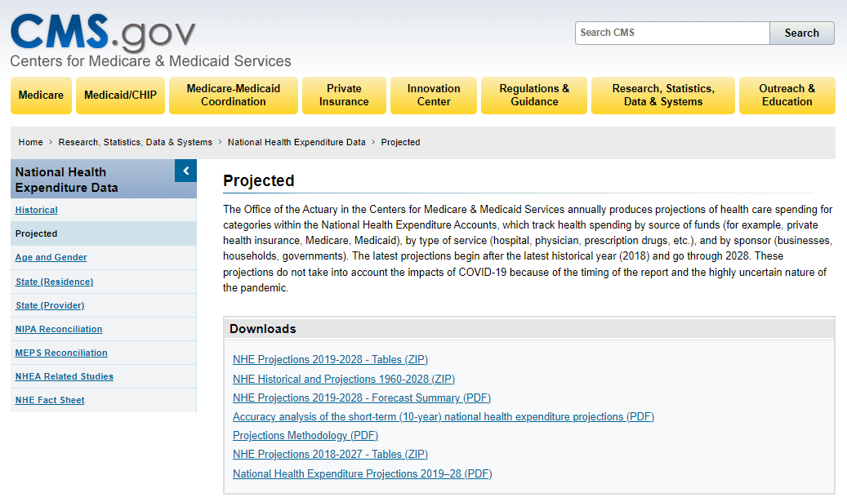
Example: Health
Cost Per Participant in that Year
Medicaid Cost
$ Per
Adult
$ Per
Child
$ Per
Disabled
$ Per
Over 65
$ Per
Adult Expansion
Notes:
We have Average Costs per Enrollee in past.
CMS has done forecasts
Perfect example of using best available data in these areas.

Slide 27
Example: Health
Medicaid Cost in a given Year
Number of Participants in that year
Cost Per Participant in that Year
Notes:
Starting out Simply

Slide 28
Input and Feedback
2040 MARA Model
Education
Public Safety
Public Works
Health
Tax and revenue
Infrastructure
Property tax
Committees
Agencies
OBPP
Stakeholders
Contractors
Notes:
We just went over an example.
LFD is uniquely situated
But as Amy mentioned there will be a feedback and

Slide 29
Modules
Everything Else
2040 MARA Model
Education
Public Safety
Public Works
Health
Tax and revenue
Infrastructure
Property tax
State Data
Personal Services
Operating
Equipment & Assets

Slide 30
State Data
Personal Services
Operating
Equipment & Assets
Notes:
Working on PS and what variables are the most important
Number of Employees – How does this change over time with population? Status Quo
Cost per employee – CPI? Does that make sense with historic growth?
Job Classification

Slide 31
Forecast Modules
Modeling
Attach to Financial Data

Slide 32
Business Intelligence Software
Link Data Sets
Notes:
BI we’ve been using at it allows us to create much more interconnected models
Several features allow for this
Link Examples

Slide 33
Business Intelligence Software
Link Data Sets
Time
Notes:
Time
Common calendar all know our fiscal year

Slide 34
Business Intelligence Software
Link Data Sets
Time
Location
Notes:
Common location set. Basically Couties

Slide 35
Business Intelligence Software
Accounting data from SABHRS
Nightly
IHS Markit economic forecasting data
Monthly
Department of Revenue Property Tax Data
REMI population forecasts by county
Annually
Biannually
Link Data Sets
Time
Location
Regular Updates
Notes:
Time
Location
Have Regular Updates
Visualize Modules and Roll Ups
Define Modular and Global Variables
Each Piece in our Forecast Formulas are Variables

Slide 36
Business Intelligence Software
Link Data Sets
Time
Location
Regular Updates
Visualize
Modules
Roll Up
Notes:
Visualize Modules and Roll Ups
Have the ability show both
ability to get into modules and see what they’re saying before we roll them up.

Slide 37
Business Intelligence Software
Link Data Sets
Time
Location
Regular Updates
Visualize
Modules
Roll Up
Define Variables
Modular
Global
Notes:
Each Piece in our Forecast Formulas are Variables
If we define them then we can use them throughout other equations.
In Medicaid we talked about several variables, one being the percentage of the population in each group

Slide 38
Population
Example
Global
Variable
Notes:
Important Variable as it drives a lot of spending and revenue (how many people you have)

Slide 39
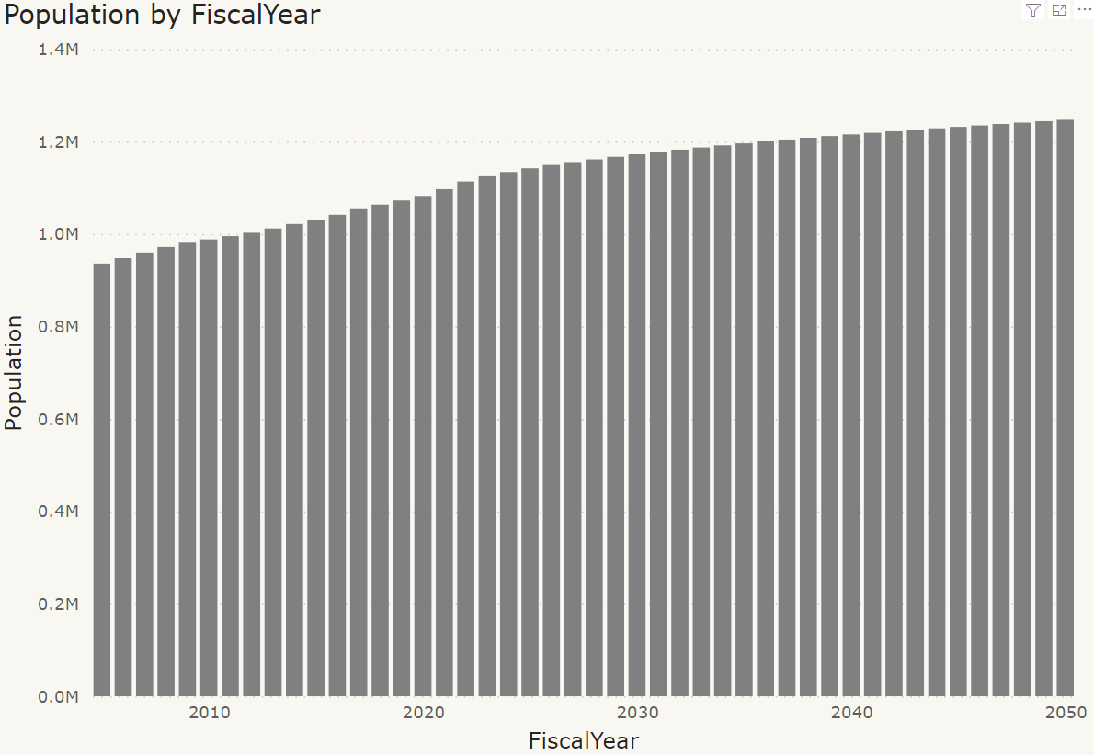
Notes:
IHS Markit – It is our population estimates for the state over time
This comes in Monthly, computer grabs it, cleans it up so the quarterly data is in our Fiscal Years
Define that as population
Use in Medicaid, but also used everywhere else.
Any time our formula needs population

Slide 40
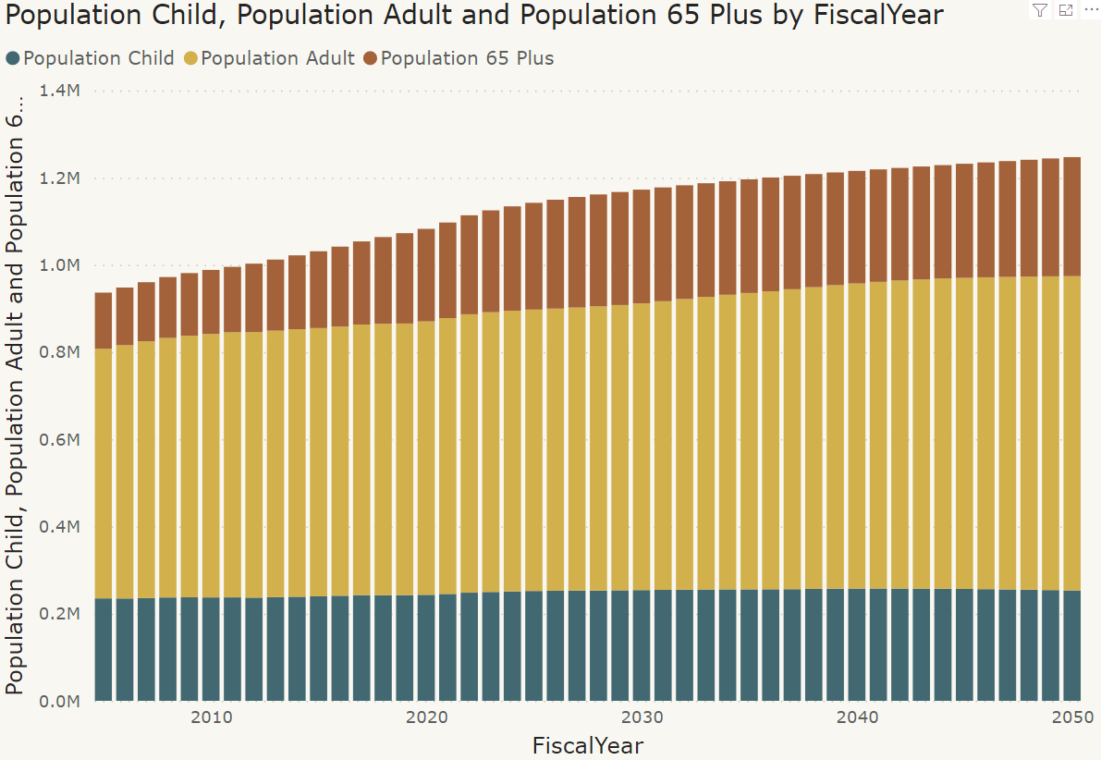
Notes:
Can Make this as groups – so the specific age groups can be applied Medicaid/School Aged children, whatever

Slide 41
Demographic Age Change
Notes:
This important
Population pyramid looks different among decades
When we define these,
every module and other forecast formula accesses
the latest forecast
simultaneously and exactly the same way

Slide 42
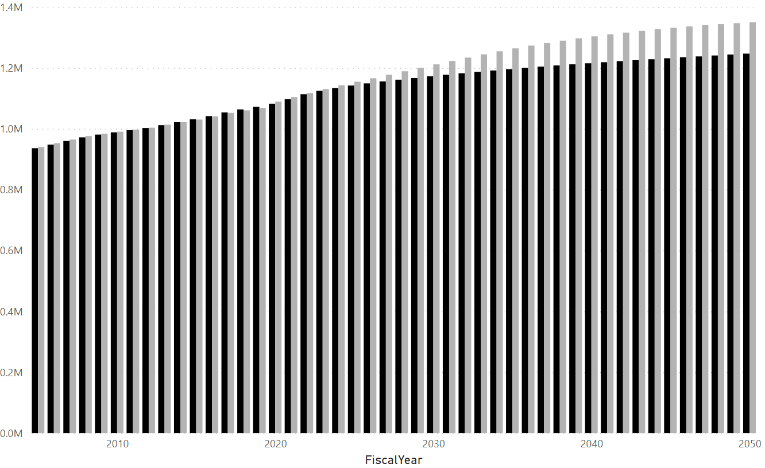
Notes:
Alternative Projections Also are part of this.
HIS is our baseline, but we also have REMI projections, and those have us about 100K more population by 2050
Absolut #s are obviously tough, but this difference affects many things.
The population variable that feeds all the age-group populations which feed the Medicaid Formula and the other module formulas were building - Connected Not only HIS but REMI

Slide 43
Scenarios
ON
OFF
Notes:
Allows us to see the effects on an expenditure category/module given different assumptions.
We will be developing a reference case
but can look at alternatives.
Limited, because we have to program.

Slide 44
Forecast Modules
Modeling
Attach to Financial Data

Slide 45
Financial Data Sets
State Accounting Data (SABHRS)
School Accounting Data (Trustee Reports)
Local Government Accounting Data (Financial Reports)

Slide 46
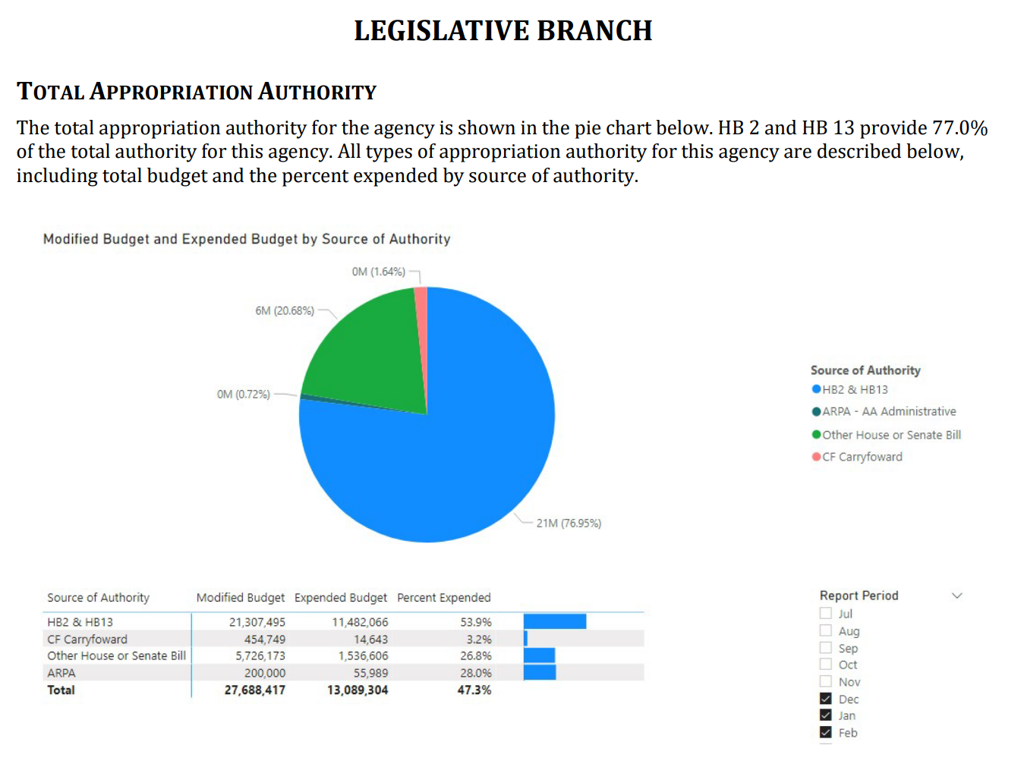
State
Accounting
Data
Notes:
Only going to talk about state:
We know the best
Can continue with the Medicaide example
Plan to do the with local and school, but not as far there.

Slide 47
SABHRS Breakout Example
SABHRS Data
Medicaid
Other Modules
All Else
Notes:
This will all be definitional
Medicaid we can break out on Regular and Expansion based on ~30 subclasses

Slide 48
SABHRS Breakout Example
SABHRS Data
Medicaid
Other Modules
All Else
History
Notes:
This establishes our History

Slide 49
Pulling it Together
Forecast Modules
Modeling
Financial Forecast
History
Notes:
By applying growth rates,
Financial Forecast have all the breakout detail, proportionally in out years as the base data.
Fund/Account/etc.
The lower you go the more careful you must be.

Slide 50
In The End
Reference Case
Scenarios
Discussion
Notes:
Reference case, bringing together
expertise of committees, agencies, and stakeholders
Look at areas of expense and revenue over time where Pop and compounding effects matter
Scenarios
How much do different assumptions matter given the compounding effects of time. What’s the delta
Discussion
MARA tasked with taking a long-term look at finances.
While more involved, This is just a tool and a forecast but if it can help facilitate a discussion about the future in a more informative way (with all the input and hopefully involvement from committees and stakeholders),
I believe it’ll be helping achieve MARA’s goals.

Slide 51
Process and Next Steps
Amy Carlson

Slide 52
Anticipated MARA meetings
Late April
Late April- 1 day
Health wrap up
Property tax model look back
June
First draft of model and property tax look forward
Committee discussion
September
Early September - 1 day
Final draft of model
Committee discussion
October
Early October – 1 or 2 days
Final model
Final committee discussion
June 23 or 24
Legislation of Interim Committees
20 year look back

Slide 53
Late April
Property tax model look back for long- term understanding property tax system
Health industry wrap up
Past expenditure and revenue review

Slide 54
June
First draft of model
Preliminary findings
Communication tools
Next steps
Committee discussion

Slide 55
Early September
Draft of model
Draft findings
Insights and observations from outside groups
Next steps
Committee discussion

Slide 56
Early October
Final Model 2022
Communication tools for the legislature
Recommended future study
Interim Committee Legislation
Committee discussion
Next steps

Slide 57
Product and Process – outside MARA
Sept & October
Describe plan, ask for insights from stakeholders, legislators, others
Model
Finish draft model
Develop communication tools
Vet model and assumptions with stakeholders, legislators, experts and others
Final draft of the model
Vet
Finalize model and communication tools
August & Sept
June & July
May & June
March & April

Slide 58
End

Slide 59
Census Crosswalk – State, Local, and Schools
Not Census data, but Census and other types of groupings of revenue and expenditure
Decades of experience in understanding how state and local government finance should be considered together
Eliminates duplicates so that transfers between government entities do not get captured multiple times – major time and credibility saver

Slide 60
Census Crosswalk - example
Local Government Expenditures
Census Category 1
SABHRS data expenditure group A
SABHRS data expenditure group B
Census Category 2
SABHRS data expenditure group C

